Slide 1
Smart Helpdesk
Monish Iyyappan

Slide 2
Proposed Solution
Complaints get lost, repeat and leave no owner or trail. Here students raise tickets, an admin assigns one owner agent, the agent resolves it, and the admin closes it with a written note.
OPEN
ASSIGNED
IN_PROGRESS
RESOLVED
CLOSED
Student raises
›
Admin assigns
›
Agent works
›
Agent resolves
›
Admin closes with a note
Live urgency
Shared incidents
Reasoned handover
Scored on every read, never stored. LOW under 20, MEDIUM 20-39, HIGH 40-59, URGENT 60+.
Many students, one incident, counted automatically.
Every agent change needs a written reason.
Closure notes
Single owner
Overdue alerts
Every closed ticket explains how it ended.
One agent per ticket, roles checked on the server.
Overdue tickets turn red and escalate a level.
Smart Helpdesk | SIH 2026 | Solution

Slide 3
Technical Approach
WORKFLOW
1 Raise
2 Assign
3 Work
4 Close
5 Review
Student files a ticket or joins an existing one.
Admin picks one owner agent.
Agent progresses the ticket and comments.
Admin closes with a written note.
Urgency, history and closed log.
ARCHITECTURE
Web app
REST API
Database
›
›
React, Vite, TypeScript, Tailwind. Hosted on Vercel.
Java 17, Spring Boot 3.4. Hosted on Render (Docker).
MySQL 8, 7 tables. Hosted on Aiven.
Backend packages: controller, service, dao, assignment, priority, security
Security and quality: HTTP Basic login with BCrypt-hashed passwords; Student, Agent and Admin roles checked on the server; 108 automated backend tests.
Smart Helpdesk | SIH 2026 | Approach

Slide 4
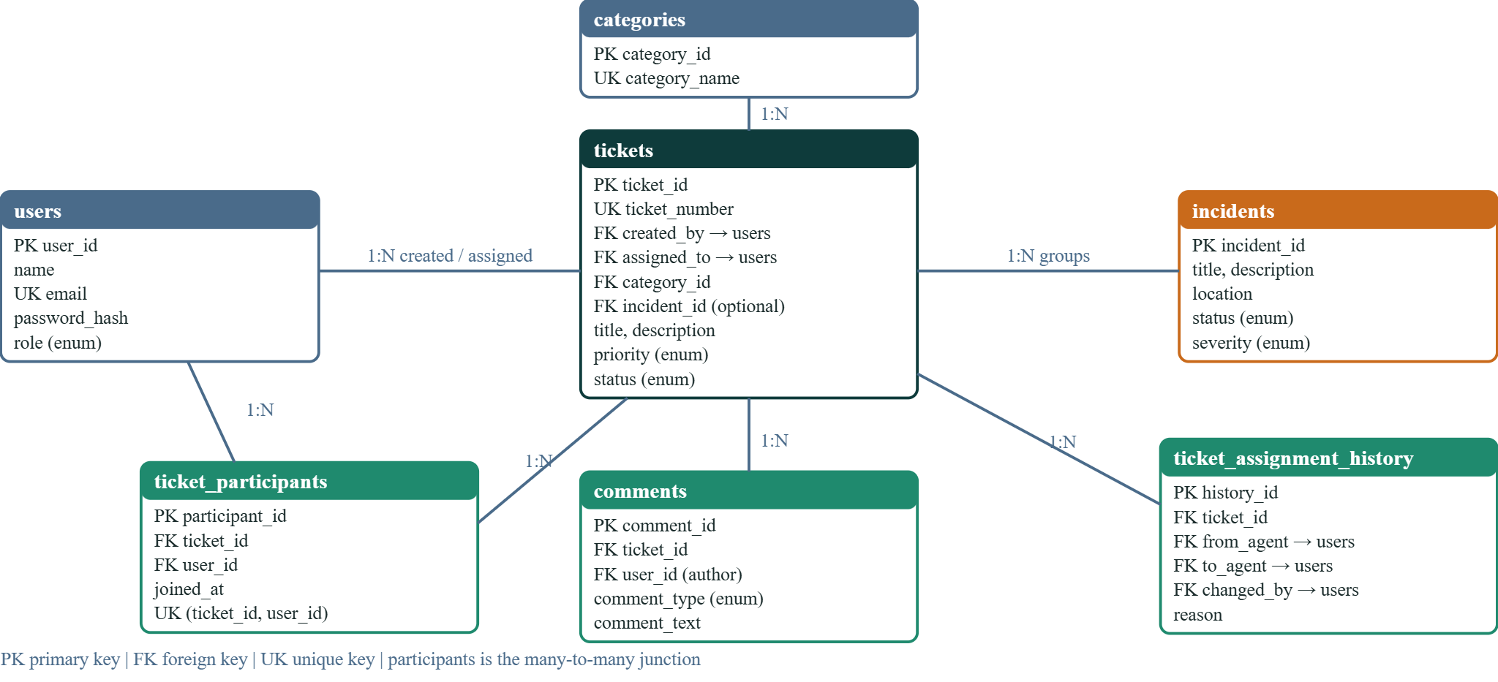
Database Design: ER Diagram
Smart Helpdesk | SIH 2026 | ER diagram

Slide 5
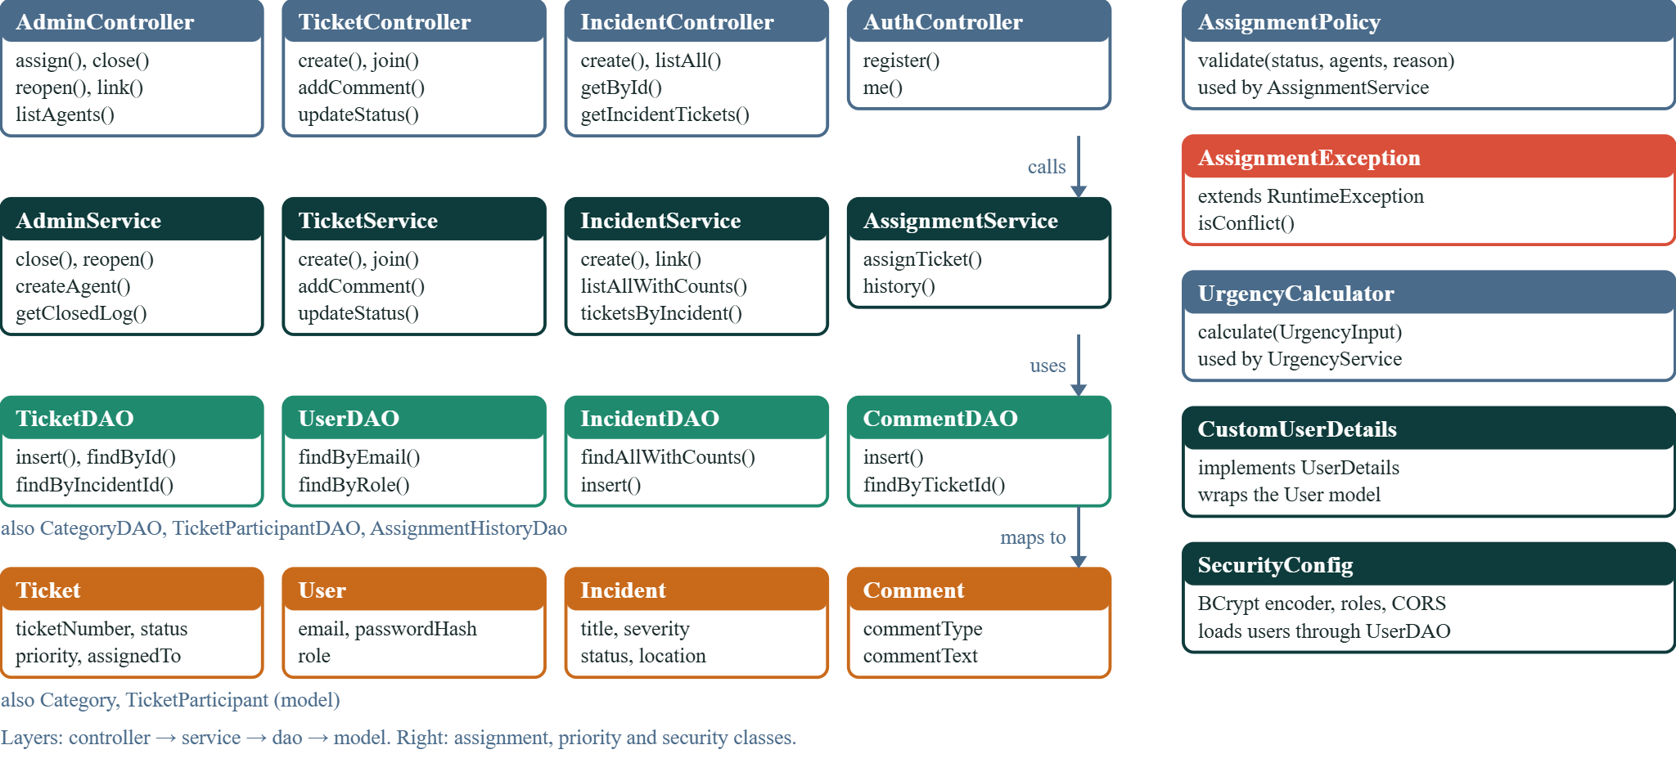
Object-Oriented Design: Class Diagram
Smart Helpdesk | SIH 2026 | Class diagram

Slide 6
Feasibility and Viability
Technically feasible
Cost effective
Operationally viable
Deployment viable
Future ready
Working prototype deployed end to end.
Open-source stack, free-tier hosting.
Three roles; assignments and closures recorded.
Runs in the browser; nothing to install.
Room for alerts, analytics and token login.
Challenge | Proposed solution
Duplicate complaints | Shared incidents; join an existing ticket by its number
Unclear ownership | One owner agent; every reassignment needs a reason
Inflated priority | Urgency computed on the server; student input capped at MEDIUM
Unrecorded closure | Closing note saved together with the status change
Basic login, no lockout | Rate limiting and lockout planned
Free-tier cold start | Always-on instance for production use
Smart Helpdesk | SIH 2026 | Viability

Slide 7
Impact and Benefits
IMPACT
Faster triage
Fewer duplicates
Clear ownership
Traceable history
Fewer missed deadlines
Urgency ranks tickets so urgent ones come first.
Students join an existing ticket or incident.
One agent per ticket; handovers need a reason.
Assignments and closing notes stay on record.
Overdue tickets stand out in red.
BENEFITS BY ROLE
Students
Agents
Admins
Management
Track by ticket number, join a ticket, comment and flag issues.
Work from one clear queue of assigned tickets.
Assign, reassign, reopen and close; watch urgency and overdue lists.
Read the closed log with closing notes and reassignment counts.
NEXT
Email or SMS alerts | Login rate limiting and lockout | Reassignment and SLA reports
Smart Helpdesk | SIH 2026 | Impact

Slide 8
Research and References
Research and documentation
Data
Prototype and tools
Spring Boot: spring.io/projects/spring-boot
MySQL 8.0 manual: dev.mysql.com/doc/refman/8.0/en/
OWASP password storage: cheatsheetseries.owasp.org
React: react.dev
Demo data: sample users, tickets, incidents and comments created for the demo.
Privacy: no real student data is used.
Categories: eight, from IT Support and Examination to Transport.
Live app: smarthelpdesk-jet.vercel.app
API: smart-helpdesk-47el.onrender.com
Source: github.com/Monish-Iyyappan/smarthelpdesk
Tools: Spring Boot, MySQL, React, Vite, Tailwind, Docker
FUTURE IDEAS
Sub-categories for each category | Agent routing by skill | Mobile app (PWA) | AI auto-categorization | Analytics dashboard
Every ticket has an owner, a reason and an ending.
Smart Helpdesk | SIH 2026 | References

